Slide 1

APEX INSTITUTE OF TECHNOLOGY
DEPARTMENT OF COMPUTER SCIENCE & ENGINEERING
Machine Learning (21CSH-286)
Faculty: Prof. (Dr.) Madan Lal Saini(E13485)
Lecture – 20
Performance Metrix for Classification
DISCOVER . LEARN . EMPOWER

Slide 2
COURSE OBJECTIVES
The Course aims to:
Understand and apply various data handling and visualization techniques.
Understand about some basic learning algorithms and techniques and their applications, as well as general questions related to analysing and handling large data sets.
To develop skills of supervised and unsupervised learning techniques and implementation of these to solve real life problems.
To develop basic knowledge on the machine techniques to build an intellectual machine for making decisions behalf of humans.
To develop skills for selecting suitable model parameters and apply them for designing optimized machine learning applications.

Slide 3
COURSE OUTCOMES
On completion of this course, the students shall be able to:-
CO1 | Understand machine learning techniques and computing environment that are suitable for the applications under consideration.
CO2 | Understand data pre-processing techniques and apply these for data cleaning.
CO3 | Identify and implement simple learning strategies using data science and statistics principles.
CO4 | Evaluate machine learning model’s performance and apply learning strategy to improve the performance of supervised and unsupervised learning model.
CO5 | Develop a suitable model for supervised and unsupervised learning algorithm and optimize the model on the expected accuracy.

Slide 4
Unit-2 Syllabus
Unit-2 | Supervised Learning | Contact Hours: 10 Hours
Regression | Linear regression, Ridge Regression, Lasso Regression, and Bayesian Linear Regression.
Classification | Types of Classification Algorithm: Binary Classification and Multi-Class Classification, Logistic Regression, K-Nearest Neighbours, Decision Trees, Random Forest, Support Vector Machine.
Performance Metrics | Performance metrics for Regression: Mean Absolute Error, Mean Squared Error, Root Mean Squared Error, R-Squared; Performance metrics for classification: Confusion Matrix, Accuracy, Precision, Recall, F1 score.

Slide 5
SUGGESTIVE READINGS
TEXT BOOKS:
T1: Tom.M.Mitchell, “Machine Learning, McGraw Hill International Edition”.
T2: Ethern Alpaydin,” Introduction to Machine Learning. Eastern Economy Edition, Prentice Hall of India, 2005”.
T3: Andreas C. Miller, Sarah Guido, Introduction to Machine Learning with Python, O’REILLY (2001).
REFERENCE BOOKS:
R1 Sebastian Raschka, Vahid Mirjalili, Python Machine Learning, (2014)
R2 Richard O. Duda, Peter E. Hart, David G. Stork, “Pattern Classification, Wiley, 2nd Edition”.
R3 Christopher Bishop, “Pattern Recognition and Machine Learning, illustrated Edition, Springer, 2006”.

Slide 6


Performance Metrics for Classification
.

Slide 7
Performance Metrics for Classification:
After doing the usual feature engineering selection, and of course, implementing a model and getting some output in forms of a probability or a class, the next step is to find out how effective is the model based on some metric using test datasets.
The metrics that you choose to evaluate your machine learning model is very important. Choice of metrics influences how the performance of machine learning algorithms is measured and compared.
Different metrics used:
Confusion Matrix
Accuracy
Precision
Recall
F1 score

Slide 8
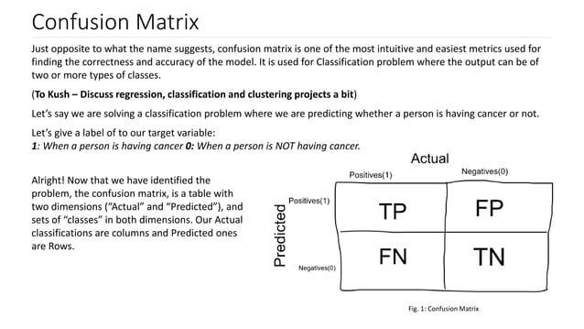

Slide 9
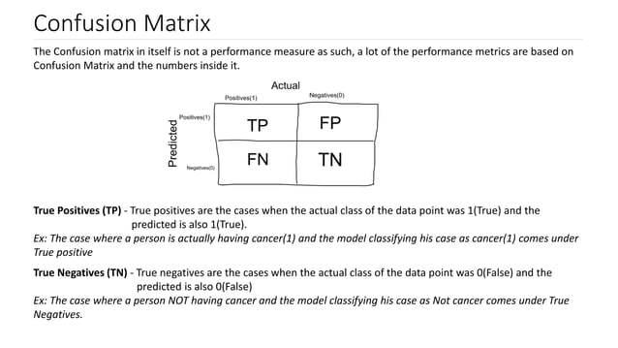

Slide 10
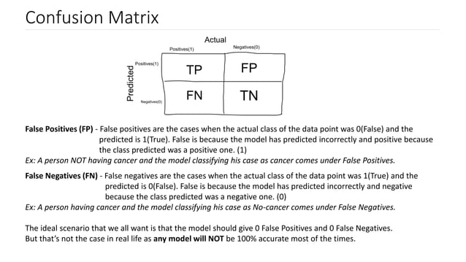

Slide 11
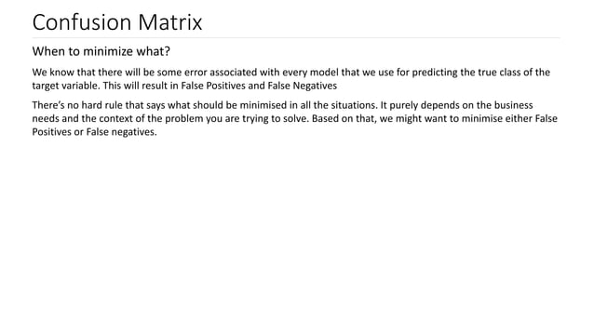

Slide 12
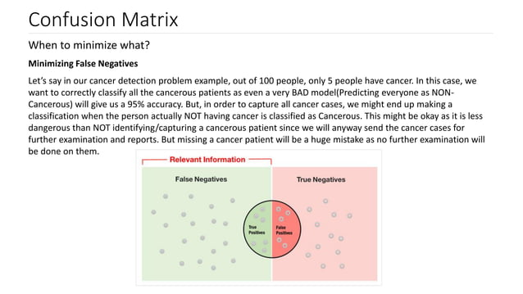

Slide 13
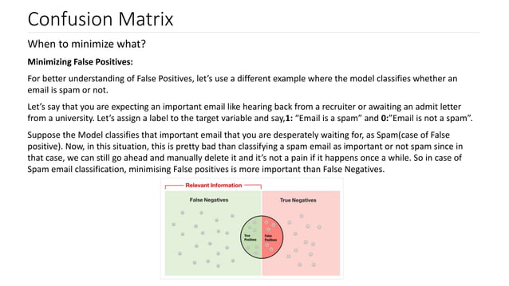

Slide 14
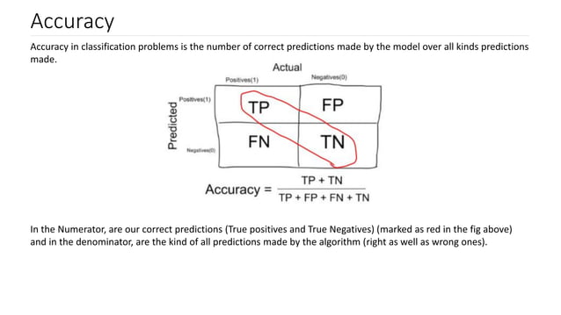

Slide 15
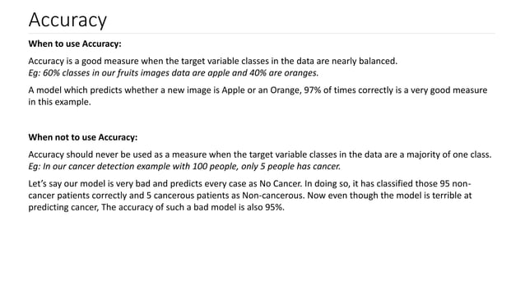

Slide 16
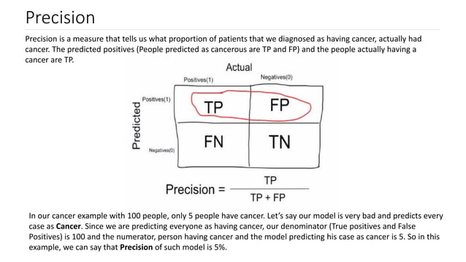

Slide 17
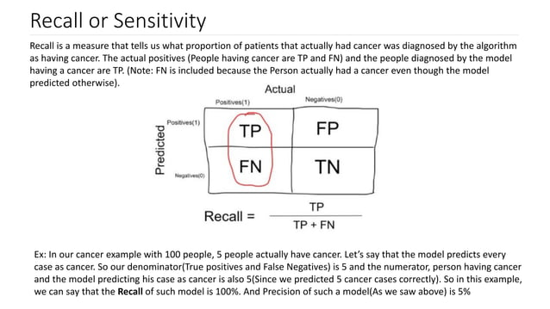

Slide 18
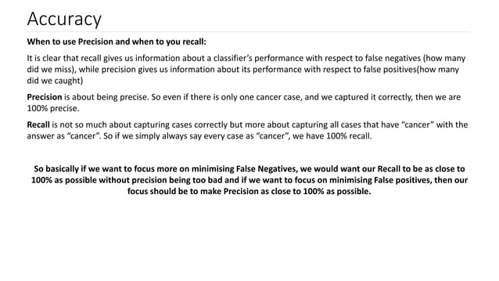

Slide 19
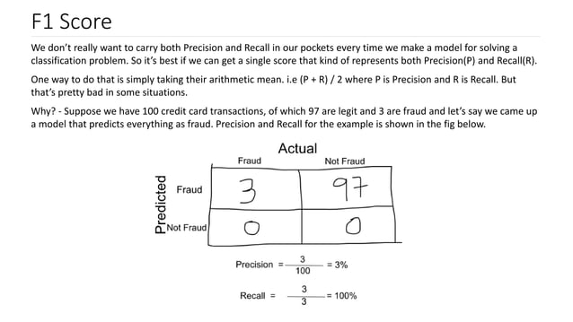

Slide 20
